Slide 1
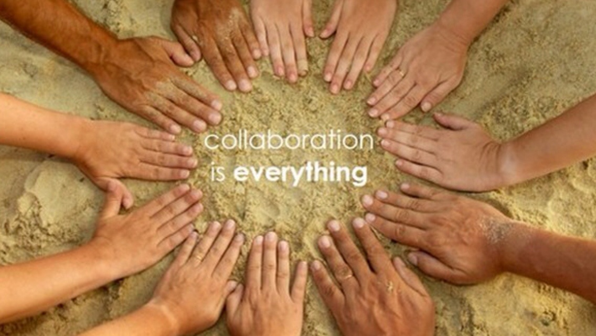
The Journey to Becoming a Supportive Professional Learning Community Teacher Leadership Certification Academy Capstone Project By Debra Baadilla

Slide 2
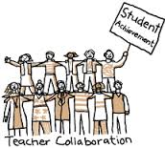
Overview of Project
I work in a small district in Riverside County. Half of our grade level was new to teaching and the concept of Professional Learning Communities (PLCs). I decided to focus on the development of a supportive PLC for the benefit of teachers and to achieve maximum academic achievement for the students.
Professional learning communities (PLCs) are social groupings of new and experienced educators who come together over time by building on their own and others' ideas and experiences in order to improve practice and enhance students' learning.
Leading educators believe that the following are critical elements of a PLC:
1. Reflective Dialogue
2. Collective Focus on Student Learning
3. Collaboration Among Members
4. Shared Norms and Values

Slide 3
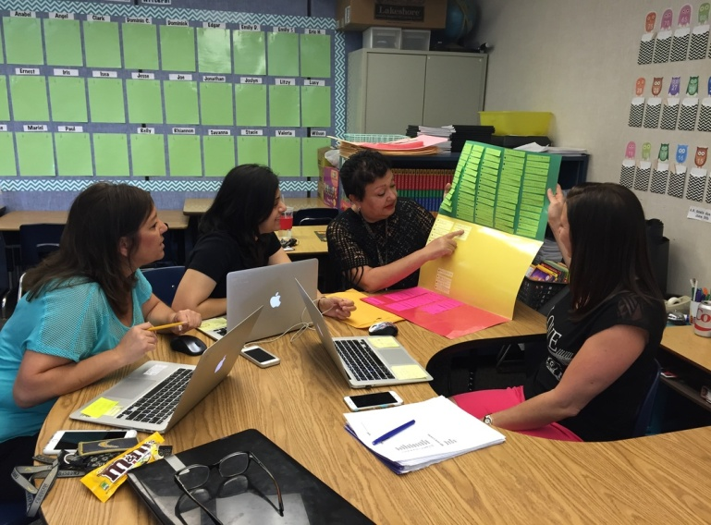
Vision Statement
As part of a Professional Learning Community (PLC), teachers look deeply into teaching and learning and how to become more effective in their work with students. Teacher learning is more complex, deeper, and more fruitful in a social setting, where the participants interact, test ideas, challenge interpretations, and process new information with each other.

Slide 4
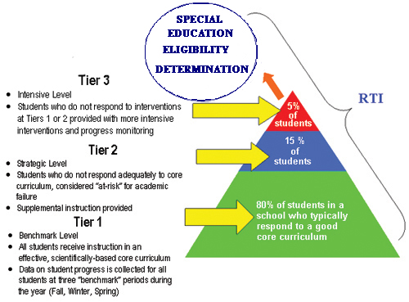
Project Vision/Goals
Establish a supportive grade level professional learning community
Develop a culture of collaboration with a focus on results.
Determine learning needs to enhance learning of Tier III students
Analyze results, make adjustments through team collaboration.
Celebrate student and teacher accomplishments!

Slide 5
Teacher Leader Model Standards
Domains/elements this project addresses
Domain IV: Facilitating Improvements in Instruction and Student Learning
4.2 Engages in reflective dialogues with colleagues based on observation of instruction, student work, and assessment data, and helps make connections to research-based effective practice.
Domain V: Promoting the Use of Assessments and Data for School and District Improvement
5.3 Creates a climate of trust and critical reflection in order to engage colleagues in challenging conversations about student learning data that lead to solutions to identified issues

Slide 6
Research
Schools as Learning Communities, Educational Leadership, DuFour, R. (2004). Three big ideas guide this school reform effort: commitment to student learning, a culture of collaboration, and a focus on results.
Teacher Collaboration and the Multi-tiered System of Support (MTSS) (2013) CRLP, Shefelbine, John, CRLP Results: How to develop, support, and sustain collaborative teams within grade levels. Focus is on lesson study to improve teaching and learning. 10 Steps for Migrating Your Curriculum to the Common Core, Fulfilling the Promise of the CCSS, Dodelson, Saki, Achieve 3000. An assessment of the changes as a result of the new common core standards. so we can change our curriculum and methodologies to meet the new standards.
Teaching Academic Vocabulary, (2005) Kinsella, Kate, Ed.D. , Aiming High, Aspirando a lo Mejor Resource, A SCOE Publication. It looks at the big picture of comprehensive strategies for helping long term English Learners build academic vocabulary.
Supporting Implementation of the Common Core State Standards: Foundational Skills CRLP Results (2014) (K-5), Shefelbine, John, Ph.D., Bruce, Gail, CRLP.This focuses on the Common Core foundational skills that students need.

Slide 7
Action Steps
Steps to build a collaborative professional learning community
Initial survey related to team dynamics to guide development of PLC
As a PLC, study the standards and curriculum (units of study)
Collaboratively develop common formative assessments with a focus on results
Develop capacity through members’ strengths
Determine learning needs to enhance learning of Tier III students
Analyze results, make adjustments through team collaboration.
Rotate responsibilities to develop leadership
Celebrate all accomplishments of the team

Slide 8
The PLC Team Timeline
Beginning August | Developing September | Growing October - May | Sustaining August-June
*Build the team. Get to know each other. Discuss confidentiality. *Bring the team together to discuss education values and vision. *Discussion of what is a PLC. Its rationale, purpose and necessity in today’s educational setting. *Development of team norms. *Establish meeting dates, times & place. | *Complete team norms. *Begin development of and complete the team SMART goal. *The goal is arrived at by looking at the most recent student data. *Formulate the plan of action. | *Share effective strategies and use them in the classroom. *Formulate common assessments and set administration dates. *Assess students regularly as it pertains to the goal. *Bring together the data and look for trends. *Address areas of weakness and strength. *Remediate students who did not achieve proficiency. Go toTier III instruction. | *Look at the data to identify teachers with strengths in areas of instruction. Share strategies. Coach each other. *Visit other team members’ classrooms to observe best practices. *Record practices that you will continue next year. *Initiate new SMART Goal as needed.

Slide 9
Qualitative Data Team Dynamics Survey
Towards the beginning of the school year, I asked my grade level team to complete a survey relative to team dynamics, as a guide to determine how to develop our PLC.
Initial Results of Survey, October, 2014: Members generally believed that we should focus less on what each other does not have or does not do and more on positive attributes.
Final Results of Survey administered in May, 2015: Members coordinate their actions to effectively reach the goals they have defined together. They may still prefer their separate roles and resources, but look for win/win improvements.
Quotes from team members as the year progressed
“My team has been so supportive “I LOVE THIRD GRADE!!”
when I needed their support and
expertise.” “We have really come together this year.
Each one provides support and it benefits
all of us.”

Slide 10
Evidence and Data – Quantitative Data Comparison of Trimester 1 and 2 scores for 14 Tier III students Dibels Next Scores – Benchmark 85 wpm

Slide 11
Evidence and Data – Quantitative Data Comparison of Trimester 1 and 2 Scores for 14 Tier III students Word Pattern encoding skills (writing) Benchmark – 85 words and elements correct

Slide 12
Next Steps
Professional Learning Community
Continue working within a culture of collaboration-share strategies.
Remain results oriented, always focusing on the goals.
Students with minimal growth will receive Reading Recovery instruction as an alternative method of Tier III instruction.
Continue to build trust and capacity within the PLC.
Celebrate all accomplishments, no matter how small!

Slide 13
Growth in the Five Practices of Exemplary Leadership
Model the Way 11. Follows through on promises and commitments he/she makes. I know that I need to take the first step in taking risks so that my team sees that I am willing to be vulnerable. I always follow through on promises that I make to my team. Inspire a Shared Vision 22. Paints the "big picture" of what we aspire to accomplish. By sharing our aspirations for student achievement, we consult with each other everyday to achieve our vision. Challenge the Process 8. Challenges people to try out new and innovative ways to do their work. We have all taken turns facilitating PLC meetings. The new teachers have attended leadership meetings on my behalf and trainings on behalf of our team.
Enable Others to Act 4. Develops cooperative relationships among the people he/she works with. By making connections with team members, we have developed and now maintain mutually respectful relationships which enhances trust.
Encourage the Heart 20. Publicly recognizes people who exemplify commitment to shared values. I have acknowledged my team’s accomplishments in person, and publicly, through media shared with the entire site.

Slide 14
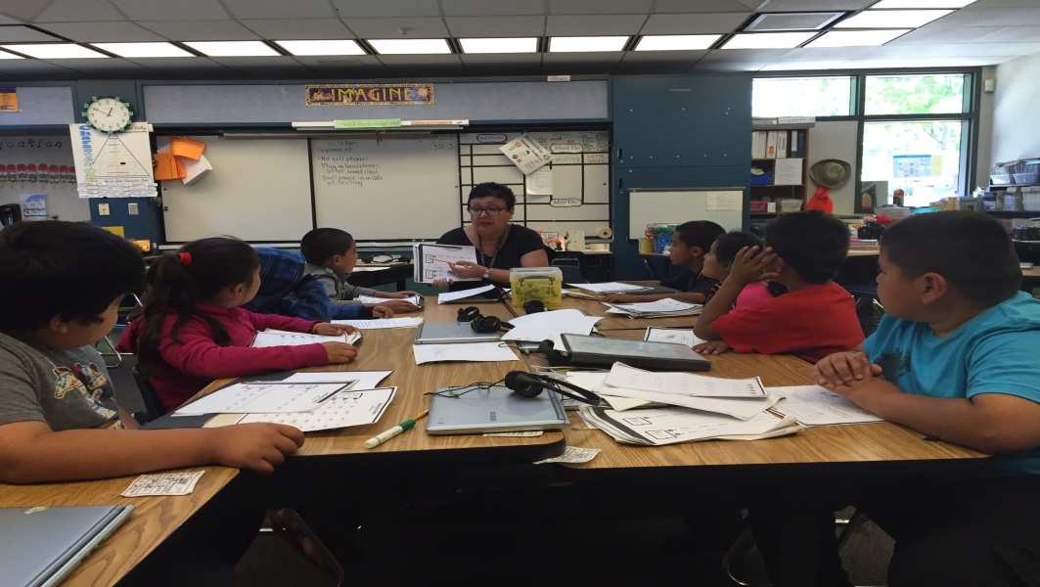
Learning/Growth
The following were the benefits of learning for myself, teachers and students:
Shared responsibility for students’ successes
New knowledge about teaching and learning
Higher morale and greater satisfaction with student achievement
Improved academic results
Recognizing gains of each teacher contributed to their increased effectiveness in the classroom, and greater satisfaction

Slide 15
Learning/Growth (continued)
MY PERSONAL GROWTH
What I learned the most about leadership is that I must concentrate on my shortcomings first to start making positive change.
I recognize that I always need to be deliberate in maintaining relationships with my team members while thinking of their needs first to continue to build trust.
I know this is an ongoing endeavor and I must never give up or become discouraged. I need to stay the course and display patience, respect, and compassion.

Slide 16
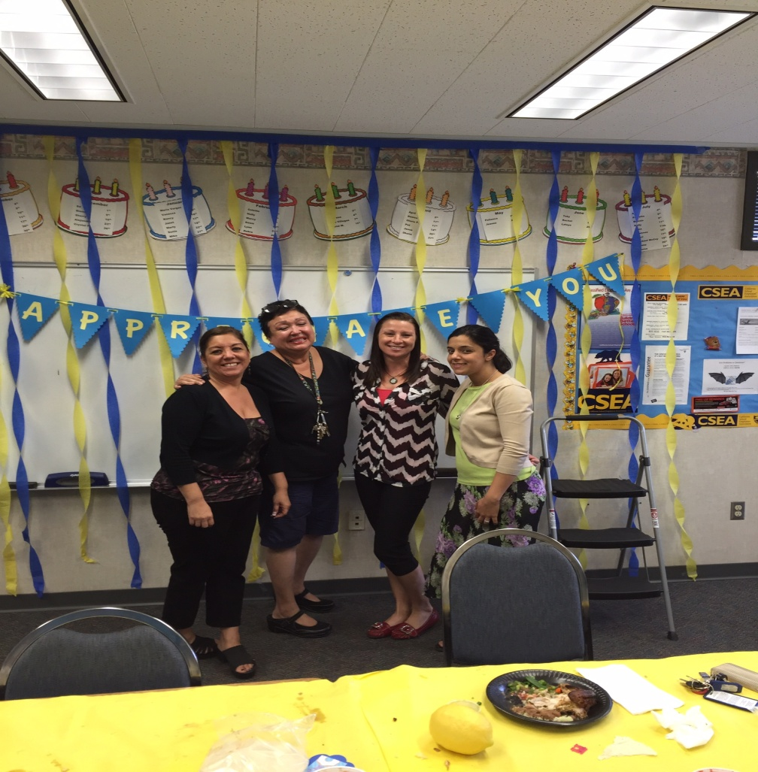
“The rise or fall of the professional learning concept depends not on the merits of the concepts itself, but on the most important element in the improvement of any school…” …THE COMMITMENT AND PERSISTENCE OF THE EDUCATORS WITHIN IT.” -RICHARD DUFOUR

